Slide 1

Global Health
Carbon Footprint Simulation

Slide 2
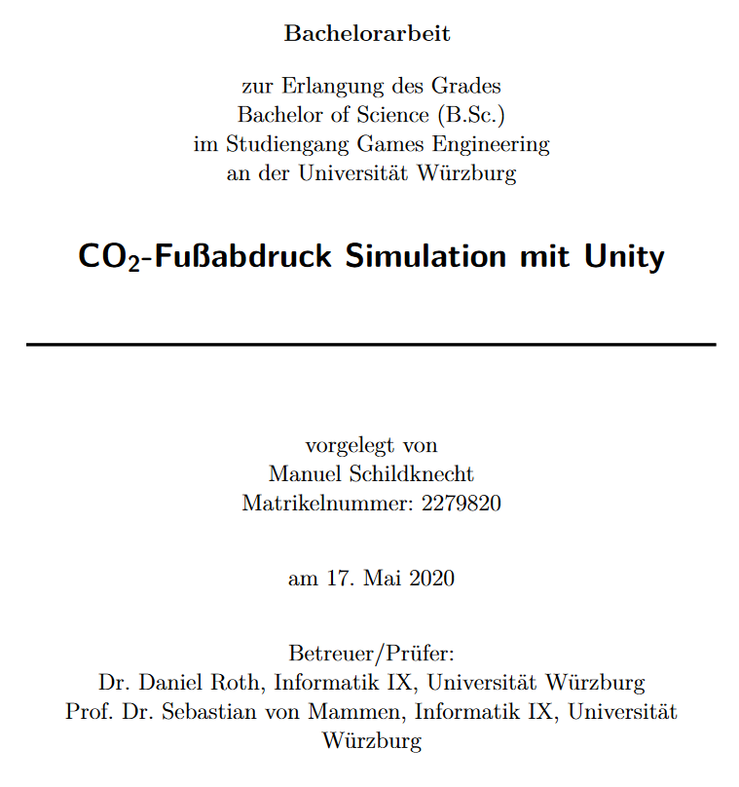
Intro and Overview
Calculators online are boring.
Engaging and Immersive approach to Carbon emission calculation.
Inspiration Thesis
Focused on how the global climate change would affect you as a Person.
Virtual test for sustainability + comparison

Slide 3
Our approach
Exploration
Triggering impacts/noticing sounds
Finding tasks/nuggets
Trying to do tasks
Doing task
Notes:
Introduction i gave today as well
Germany based
Timeframe
Scaling
Daily day in your life
Routine tasks
(Nothing besides these tasks is tracked)
Exploration
Impacts shown ingame while playing

Slide 4
Tasks
Must fit in scheme of avg. day
No tedious tasks
Tasks/emissions should be influenceable by the player
All tasks can be discovered
Triggered automatically in case player takes too long

Slide 5
Tasks/Emitters
Food
Laundry
Recreation
Transportation
Electricity
Heating
Notes:
Food task issue of eating stuff because already bought alternative would be to throw away
Transportation hard to influence on a level of driving 20km to work

Slide 6




Story/Nuggets
but…
Exploration gameplay
Story makes “daily” tasks more interesting
Story isn’t coherent, it only is background nuggets
More complex story maybe even possible
Notes:
Character could have a quirk and by exploring you understand where that comes from
Dangerous to shift too much focus from co2 away to a story maybe as well

Slide 7
Impacts
Floods
Mosquitoes
Loss of species
Notes:
Research was limited, hard to find actual values for what might happen when
German setting, USA might be better
Species impact is meh

Slide 8
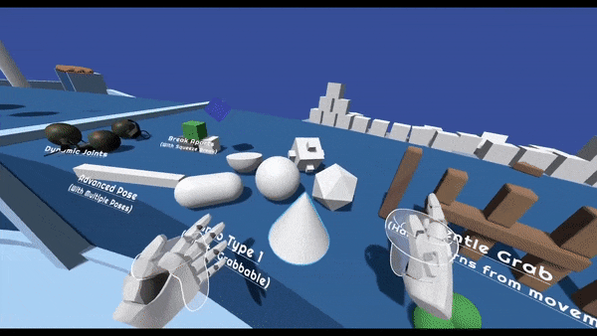
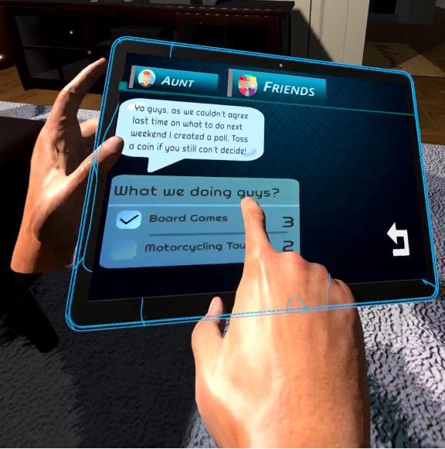
VR & Immersion
Why? - User feels embodied in the virtual avatar.
Why? Makes decisions as if they are making them for themselves.
Why? So they don’t leave the lights open.
Edited fully interactive Apartment.

Slide 9
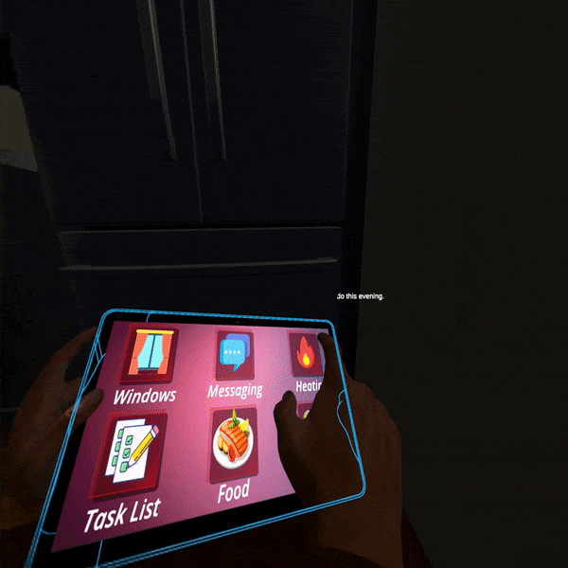
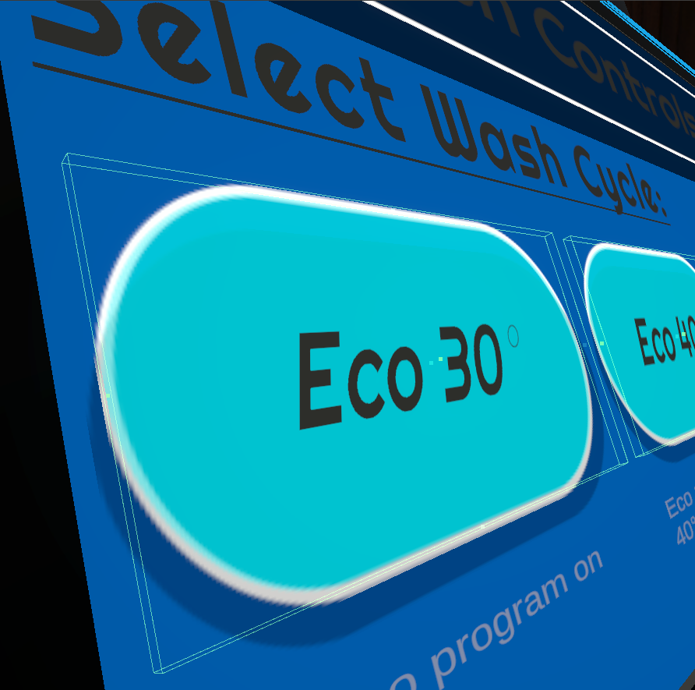
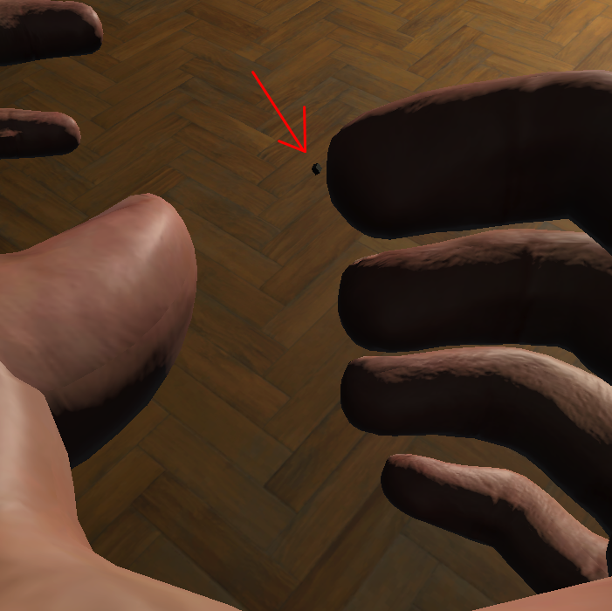
Tablet
A single place for all tasks.
Saved time and effort. (Windows/Radiator/Laundry)
VR-UI interaction

Slide 10
Audio
Environmental sounds
Interactable objects
Impacts
Voice lines
Notes:
Need of voice lines
How
Limitations (voice actors etc.)

Slide 11
Audio
Environmental sounds
Interactable objects
Impacts
Voice lines
Environmental sounds
Interactable objects
Impacts
Voice lines
Notes:
Need of voice lines
How
Limitations (voice actors etc.)

Slide 12
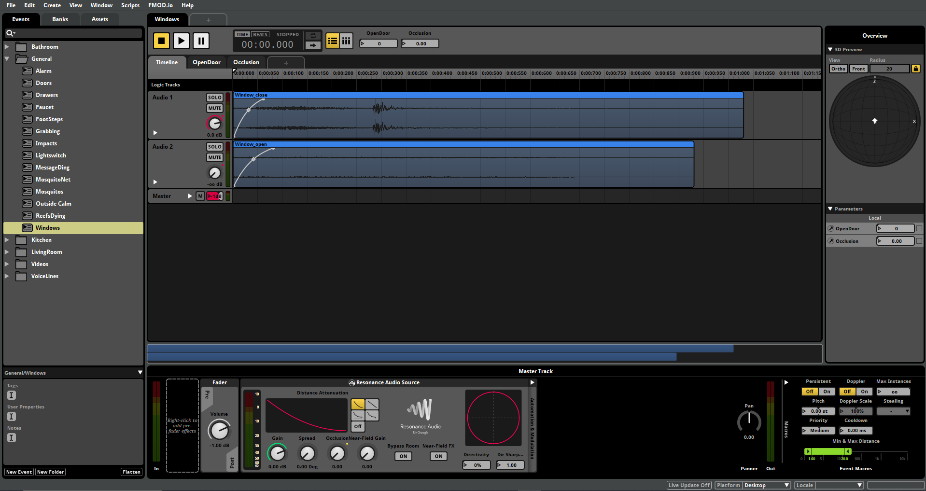
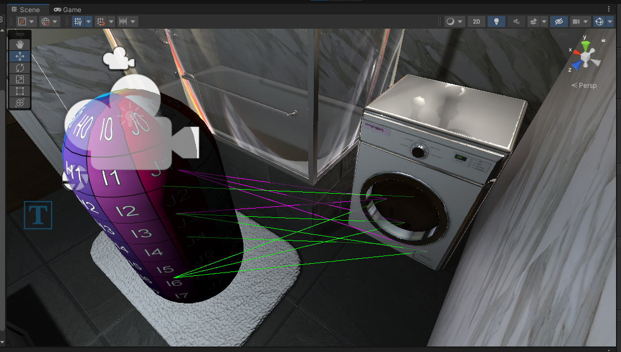
FMOD & Resonance Audio
Notes:
Need of voice lines
How
Limitations (voice actors etc.)

Slide 13
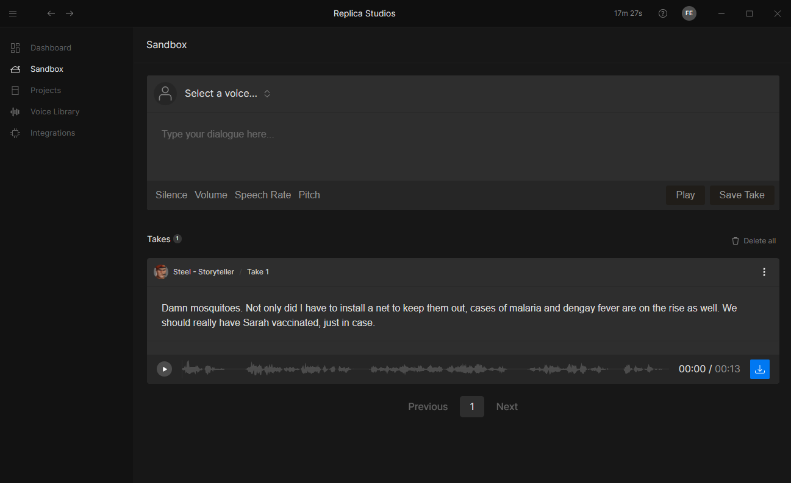
Voice Lines
Impacts
Story-nuggets
Tasks
Organic discovery
Non-organic discovery
Reminder
Completion
Notes:
Need of voice lines
How
Limitations (voice actors etc.)

Slide 14
Results of testing session & expo
7 votes

Slide 15
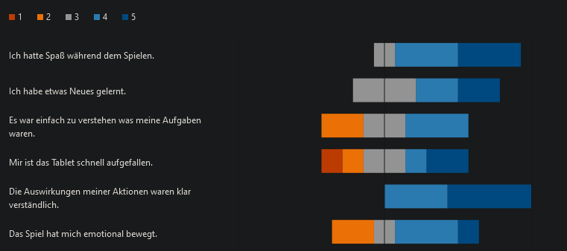
Results of the testing session

Slide 16
What to improve
Missing VR tutorial
Few people read intro & outro texts
Basically nobody turned the lights on
In-game impacts very rarely seen
Doing tasks only via tablet is not ideal
Tablet is too janky

